Slide 1
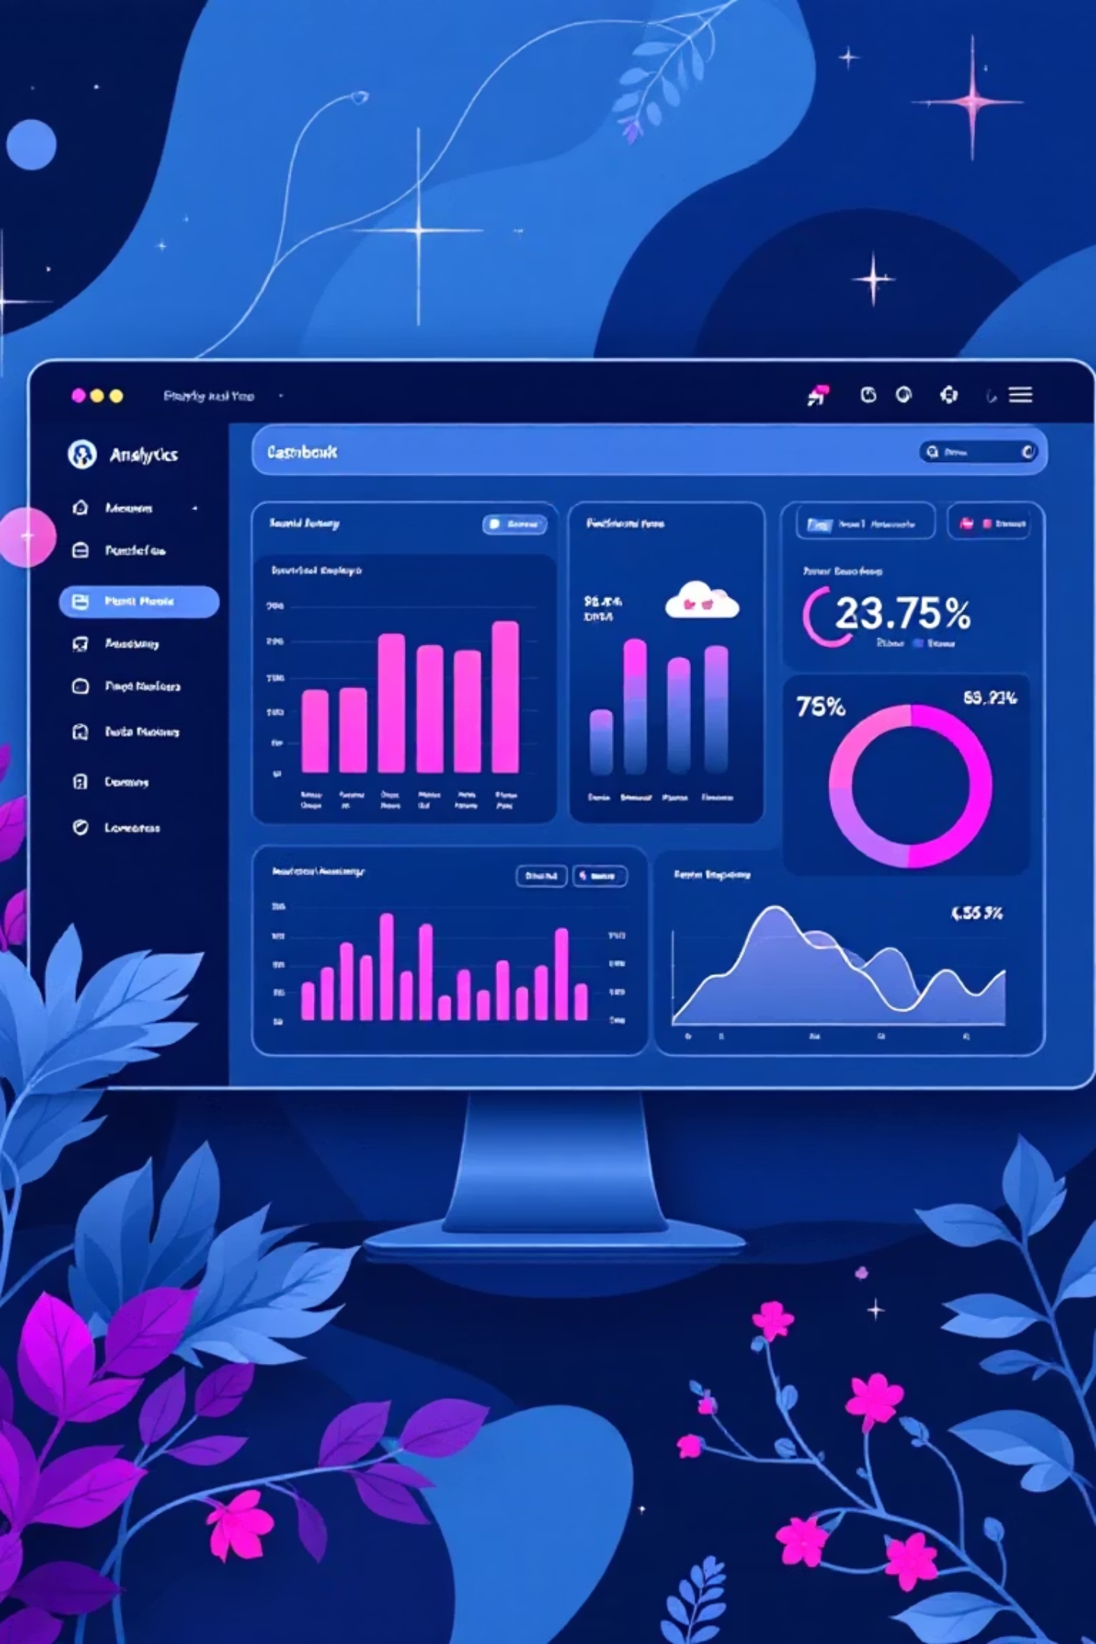
Customer Shopping Behavior Analysis
Uncovering insights from 3,900 purchases to guide strategic business decisions

Slide 2
Dataset Overview
3,900
18
50
25
Total Purchases
Data Points
Locations
Products
Transactions analyzed
Features per transaction
Geographic coverage
Items tracked
Customer Data
Transaction Details
Behavior Metrics
Age, Gender, Location
Product, Category, Amount
Review Ratings
Subscription Status
Season, Size, Color
Shipping Preferences
Purchase History
Discounts & Promos
Purchase Frequency

Slide 3
Data Preparation Process
01
02
03
Data Loading & Exploration
Missing Data Handling
Feature Engineering
Imputed 37 missing Review Rating values using median rating per product category
Created age_group bins and purchase_frequency_days columns for deeper analysis
Imported dataset using pandas, analyzed structure with df.info() and summary statistics
04
05
Data Standardization
Database Integration
Renamed columns to snake_case, dropped redundant promo_code_used field
Connected to PostgreSQL and loaded cleaned data for SQL analysis

Slide 4
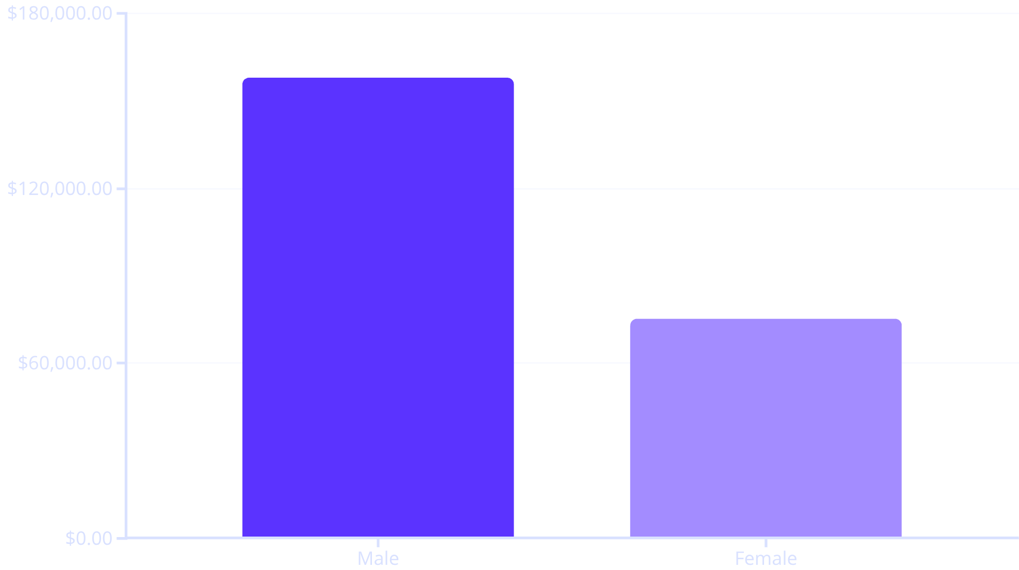
Revenue Insights
Gender Revenue Gap
Male customers generate 2.1x more revenue than female customers
Total revenue: $233,081
Male customers represent 68% of total revenue despite similar purchase patterns

Slide 5



Smart Discount Users
839 Customers
High-Value Buyers
Used discounts but spent above average ($59.76)
Discount users aren't always low spenders
Strategic Opportunity
Balance promotions with margin control
Key Finding: 21.5% of customers use discounts while maintaining above-average purchase amounts, suggesting discounts attract quality buyers

Slide 6


Product Performance
Top 5 Products by Rating
Discount-Dependent Products
3.9
50%
Gloves
Hat
3.8
49.7%
Sandals
Sneakers
3.8
49.1%
Boots
Coat
3.8
Hat
48.2%
Sweater
3.8
Skirt
47.4%
Pants

Slide 7



Customer Segmentation
Returning
701 customers (18.0%)
Made multiple purchases, growth potential
Loyal
3,116 customers (79.9%)
Frequent repeat buyers driving core revenue
New
83 customers (2.1%)
First-time buyers to nurture
Subscription Impact
Opportunity
958 repeat buyers (>5 purchases) have subscriptions
72% of repeat buyers aren't subscribers yet
2,518 repeat buyers remain unsubscribed
Massive conversion potential

Slide 8


Subscription Analysis
27%
73%
Subscribers
Non-Subscribers
1,053 customers with active subscriptions
2,847 customers without subscriptions
Subscribers
Non-Subscribers
Insight
Avg spend: $59.49
Avg spend: $59.87
Similar spending patterns suggest subscription benefits need stronger promotion
Total revenue: $62,645
Total revenue: $170,436

Slide 9
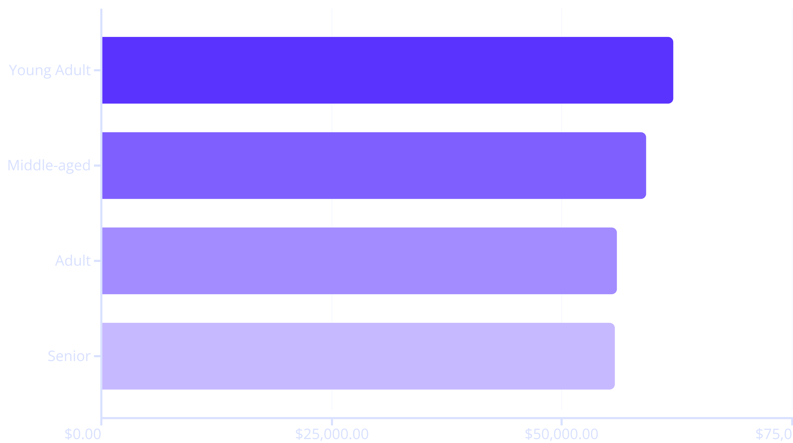
Age Group Revenue Distribution
Shipping Preferences
Category Leaders
Express shipping: $60.48 avg
Clothing: Highest revenue and sales
Standard shipping: $58.46 avg
Accessories: Strong second place
Express users spend 3.5% more per transaction
Footwear & Outerwear: Consistent performers

Slide 10
Strategic Recommendations
Boost Subscriptions
Loyalty Programs
Review Discount Policy
Promote exclusive benefits to convert 2,518 repeat buyers without subscriptions
Reward repeat buyers to accelerate movement into "Loyal" segment (79.9% retention)
Balance 50% discount rates on top products with margin control strategies
Product Positioning
Targeted Marketing
Highlight top-rated items (Gloves, Sandals, Boots) in marketing campaigns
Focus on Young Adults ($62K revenue) and express-shipping users (higher spend)

